Slide 1
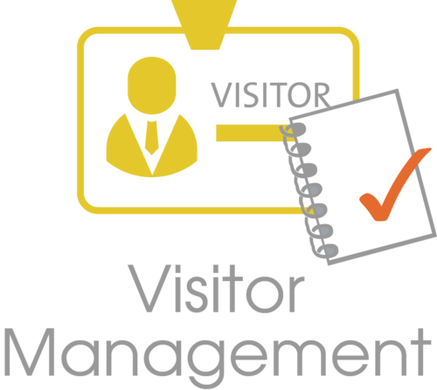
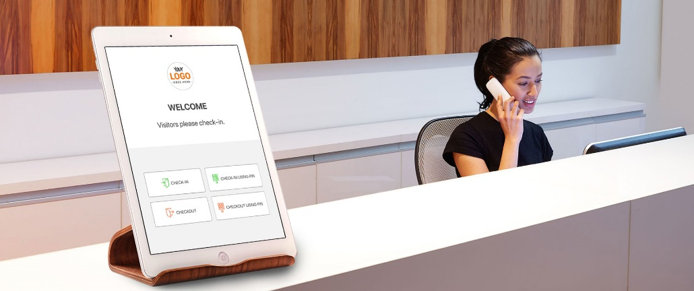
Visitor App Training Manual
July 2021

Slide 2
Programme
Session 1
Opening & Welcome
Ground rules
Session 2
Requester
Issuing
Session 3
Completion of the Change Readiness Assessment (amended)
User input and feedback on training session
Project objectives
What are you expectations
Training video
Project benefits
Milestones
Stakeholders
Project champions
Closure
Approver
Change curve

Slide 3
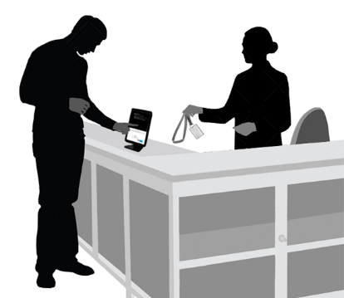
Ground Rules
This is a training session and we are encouraged to interact
Making mistakes is the best way to learn
Your opinions matter
Feel free to ask as many questions as possible
Ignore your phones and other gadgets
Covid-19 is still a real threat, therefore, sanitise, wear facemasks, practice social distance
Covid-19 is not permanent.

Slide 4
Project Objectives
Sensitise employees in general and managers (A-F) in particular of the initiative.
Highlight new opportunities for Transnet Engineering to ‘Go-Digital’ starting with the Visitor App.
Emphasis on the benefits of adopting a ‘Go-Digital’ approach to doing business.

Slide 5
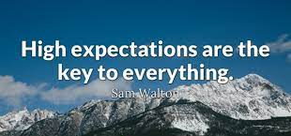
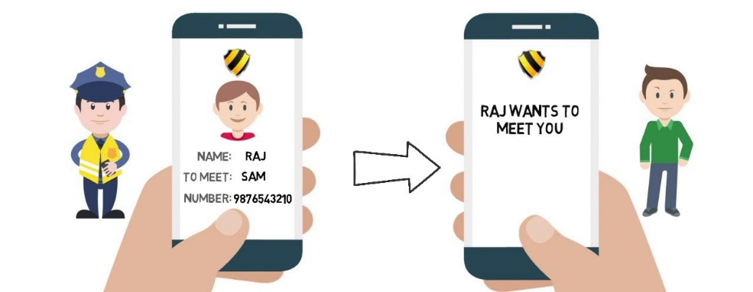

Slide 6
User Expectations

Slide 7
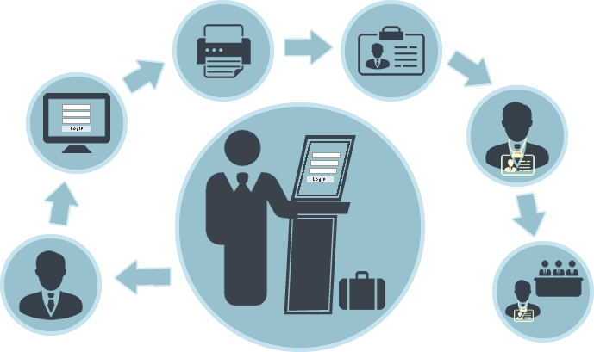

Slide 8
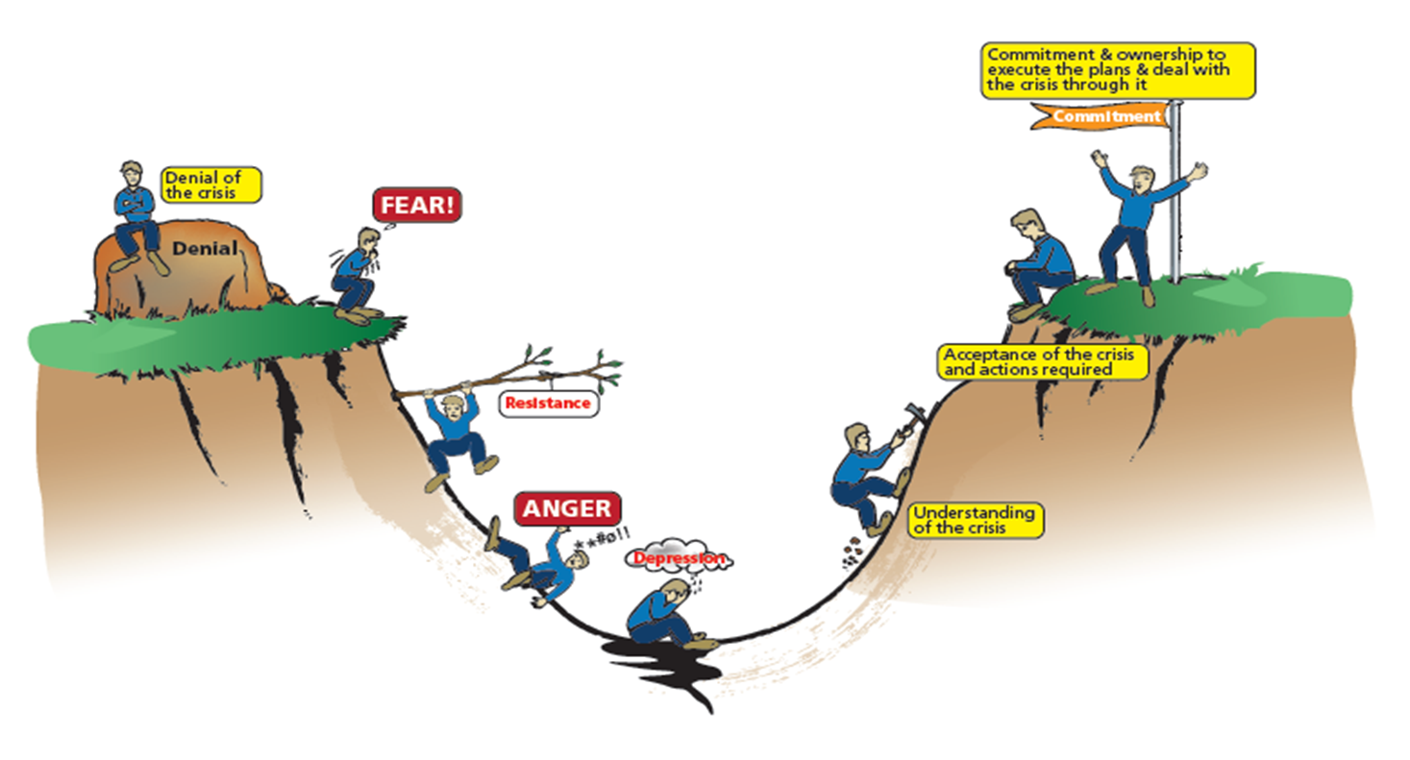
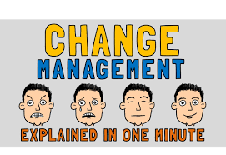
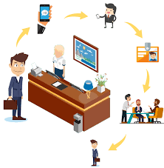
The Change Curve

Slide 9
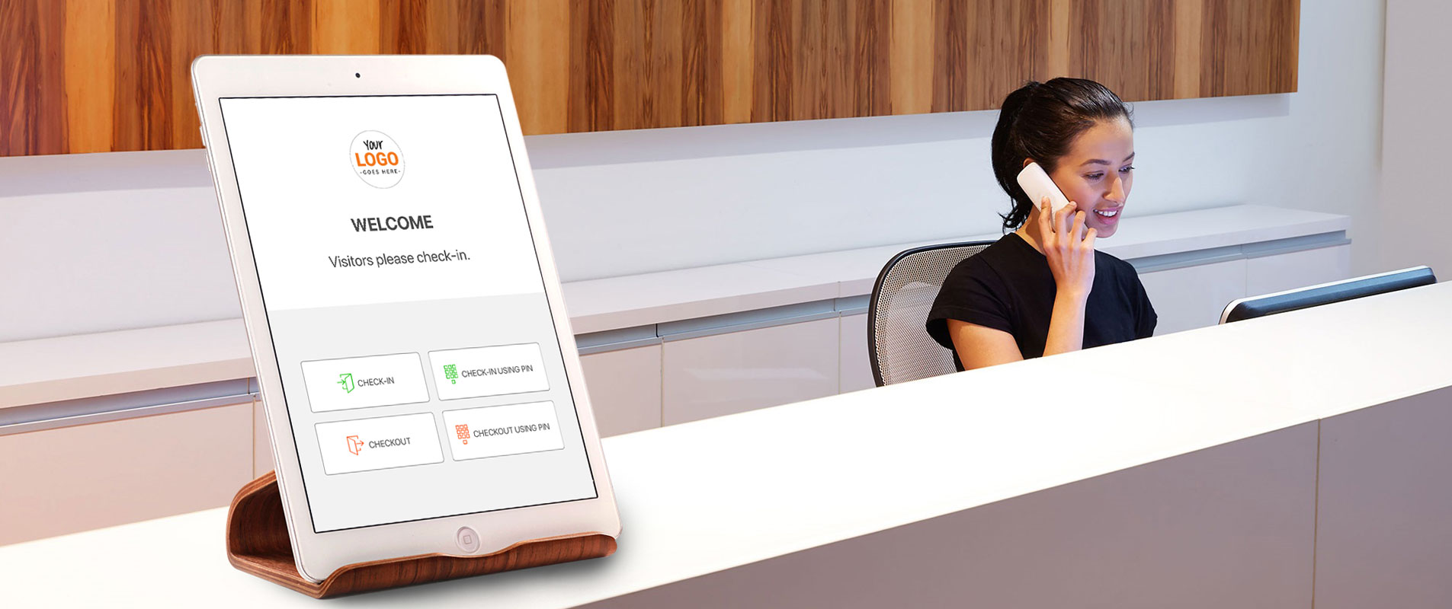
Benefits and Impact
The solution will improve TE’s security and ensure compliance with induction in terms of TE’s Safety, Health and Environmental (SHE).
TE’s customers, can expect confidentiality of information, visitor recognition, utilising state-of-the art technology to register, manage, and display, relevant visitor details as they check in.
Among others, the primary benefits include, creating a digital visitor record system,

Slide 10
Benefits and Impact
Improving employee safety, creating and improving visitor brand experience,
Reduction in visitor procedure and process, improved TE’s ability to manage ,
Track and trace visitors in our premises, possible reduction in asset losses.

Slide 11
Stakeholder Analysis
Stakeholders Identification
Project
Sponsor
C-D leadership
E-F Management
All Employees
Project SteerCo
TE Employees
ICT
SHER
Pilot site employees

Slide 12
Timelines (Milestones)
Milestone 1
Go-Live
Milestone 1
c
b
Milestone 1
a
Milestone 1

Slide 13
Project Champions
Business
Technical Support
Overall Champion
a

Slide 14
Technical Content

Slide 15
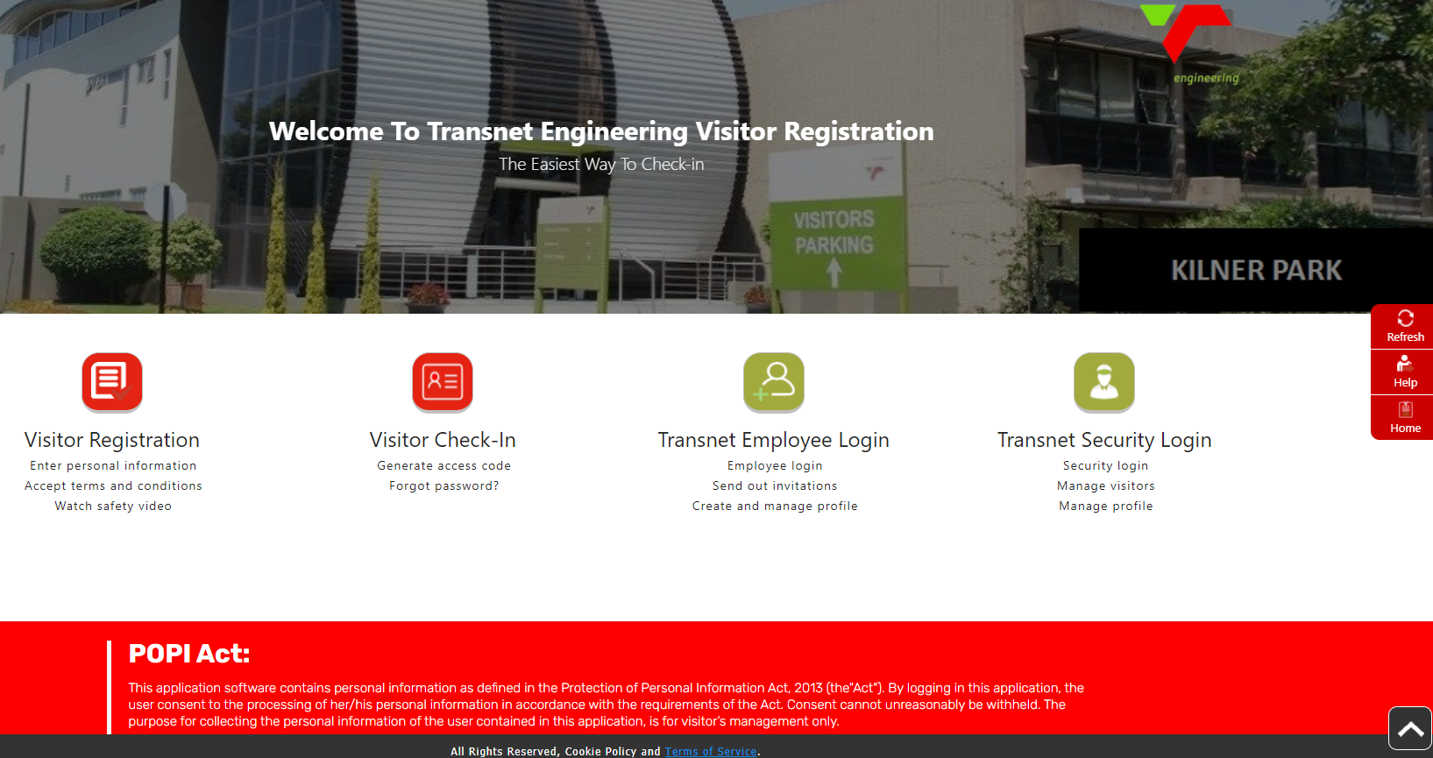
Visitor App landing page
Click on Visitors Registration icon and the registrations screen will be displayed then fill-in the required information on the appropriate fields as per segments reflected below:

Slide 16
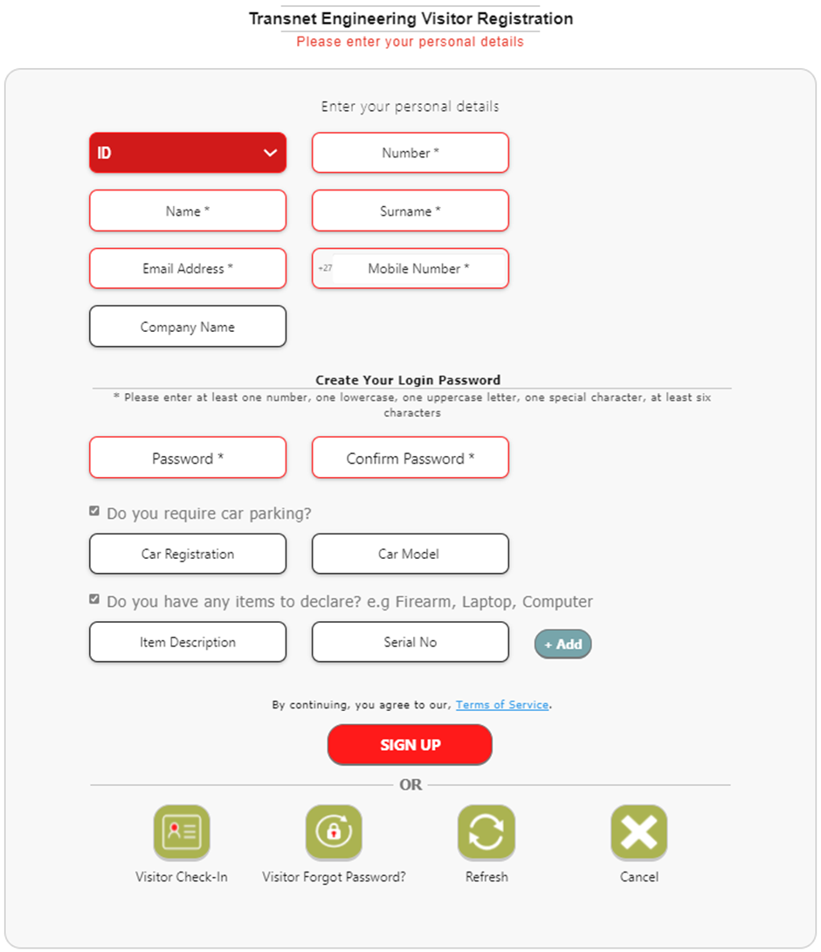
User_id and password
Type in your personal details

Slide 17
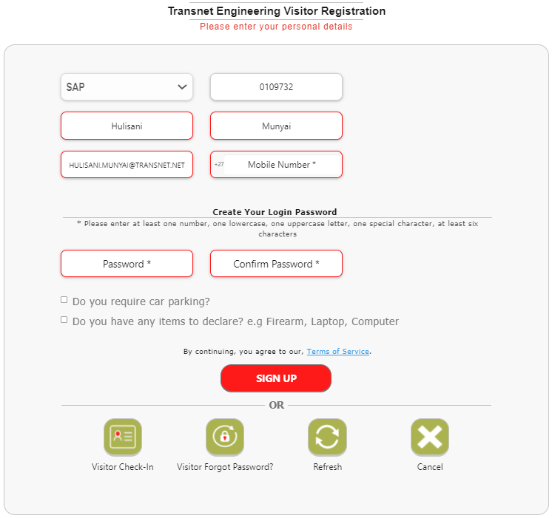
User_id and password
Once all the required fields are populated with data then click on
icon at the bottom of the screen and then the pop-up screen which reads “Your registrations has been successfully completed” will appear.

Slide 18
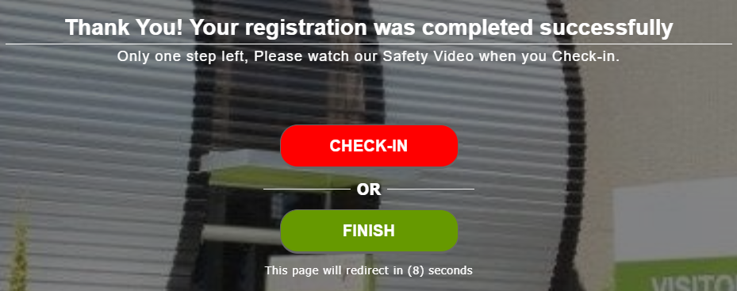
Registration successfully completed
Note: Registration simply means you are registered as a potential visitor to any Transnet Engineering (TE) premises and you can be able to login into the system.

Slide 19
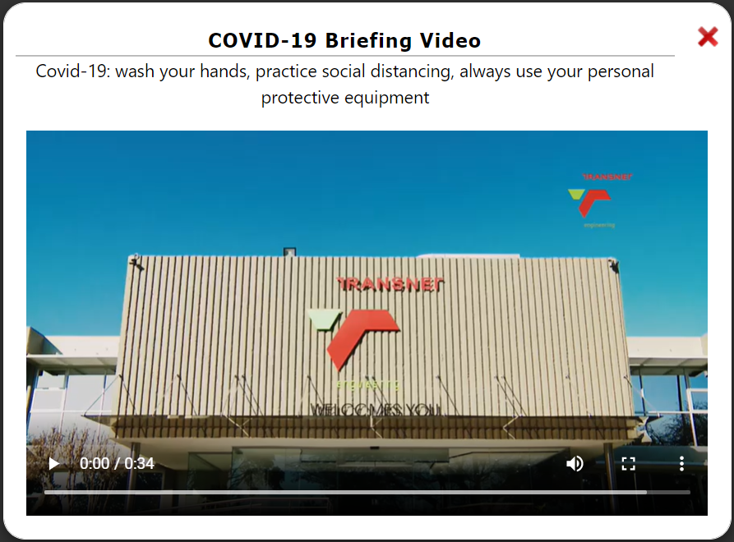
Check-in (access code)
Pre-Requisites
A registered user should exist on TE Visitors App.
With the valid user you should be able to click on
icon and checked-in. Once checked-in the COVID19 Briefing Video will automatically start playing.

Slide 20
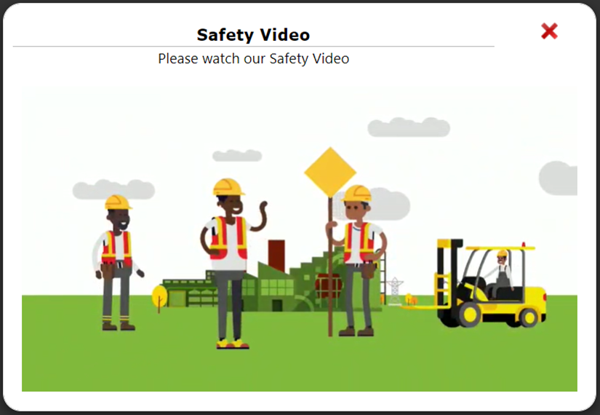
Safety video
Pre-Requisites
Once all of the above fields are populated then click on icon
at the bottom of the screen to check-in and it’s upon checking-in the Transnet induction video will start playing automatically.
Note: It is important to pay attention to induction video because the questions that need to be answered thereafter will be directly related to the video.

Slide 21
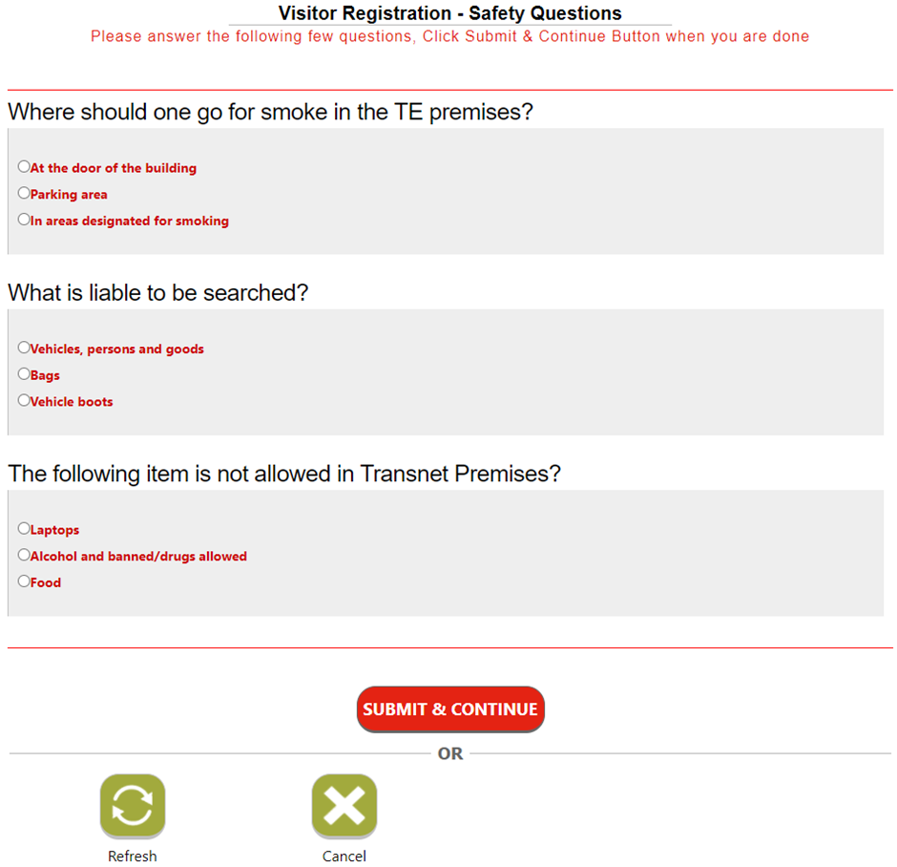
Safety comprehension
Pre-Requisites
Visitors will be required to share their understanding of the basic safety protocols of the site.

Slide 22
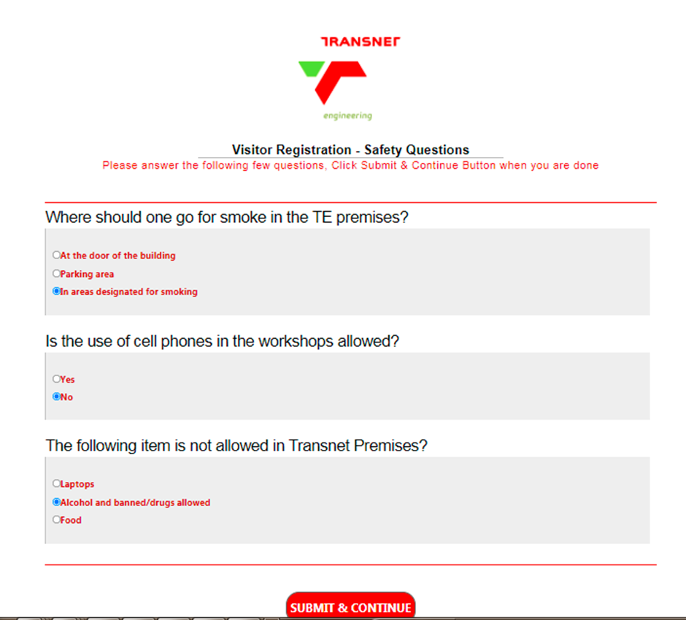
Submit Assessment
Once satisfied with the answered provided then the individual should click icon
at the bottom of the screen.

Slide 23
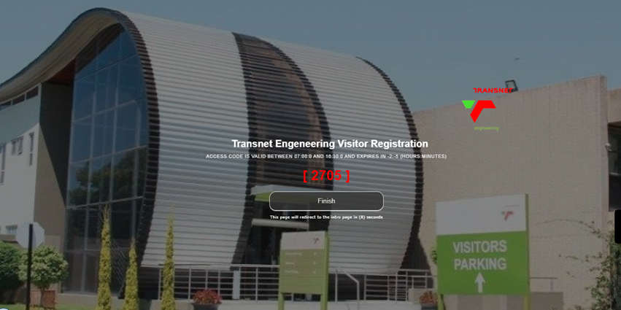
Submit Assessment
Once satisfied, the system will generate access code, which will be displayed on the screen as reflected
Note: It is important to pay attention to the access code generated because it is the same code which will be required by Security Officers

Slide 24
Plant Number
Once the video stop playing then the check-in screen will appear which will prompt individual to select the drop-down arrow and select reasons for the visits. and select reasons for the visits. The following are the reasons options available:
Meeting
Training
Deliveries
Sporting event
Other

Slide 25
Centre details
The next drop-down option arrow is for the Centres then select the Centre to be visited on the drop-down list. Thereafter enter the email address and the password created upon registration on the appropriate fields provided
Email Address and Password

Slide 26
Security (Access Control)
Pre-Requisites
A valid access code generated for a specific Centre to be visited.

Slide 27
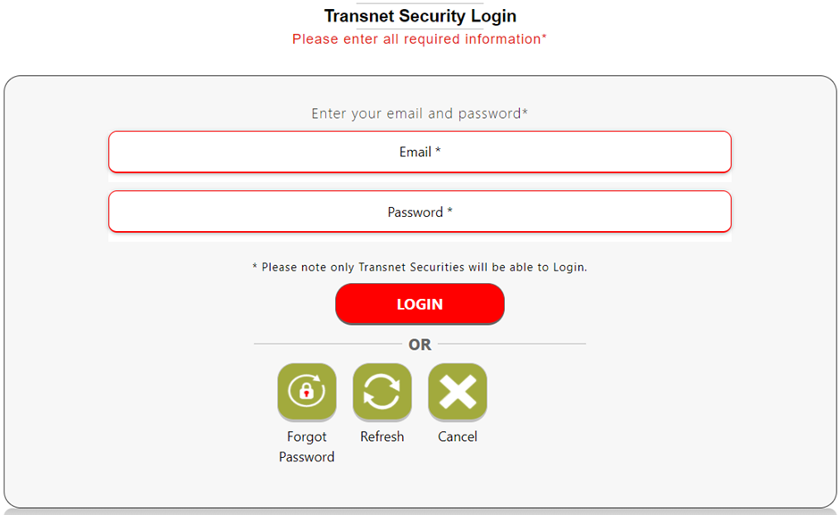
Security (Access Control)
Pre-Requisites
The Security Officer should fill-in the required information on the appropriate fields as reflected

Slide 28
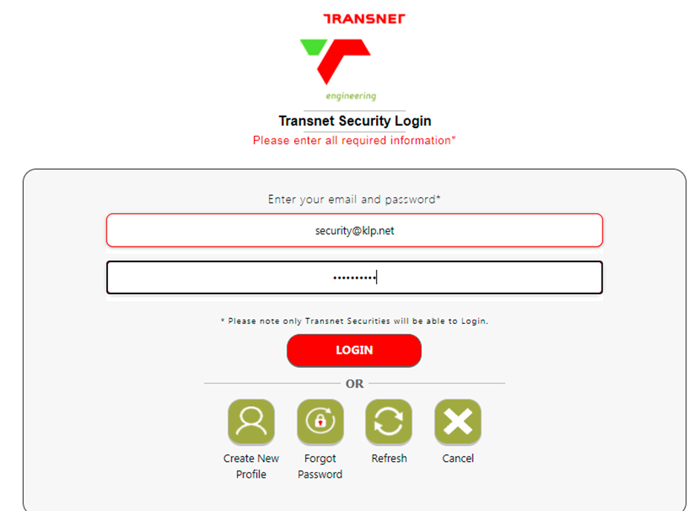
Log-in page
Then click icon
at the bottom of the screen and the security landing page will be displayed with the list of registered visitors at the lobby and ready to be checked-in by the Security Officers on duty

Slide 29
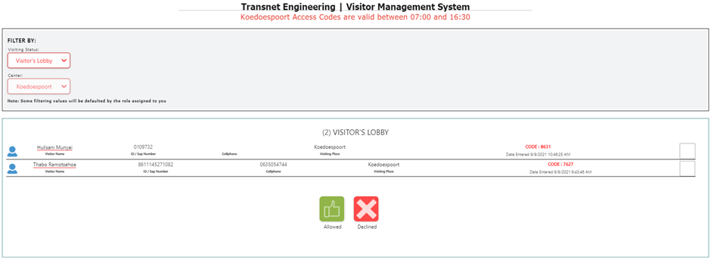
Log-in page
Note: The access code expires at a certain time hence it is important for the anticipated Visitor to register at least a day before or earlier on the day of the visit in order to ease the Access Control process.

Slide 30
Visitor Arrival
Upon arrival of the anticipated Visitor at Transnet Engineering premises the Security Officer on duty will ask for the access code and check if the provided code is available on system.

Slide 31
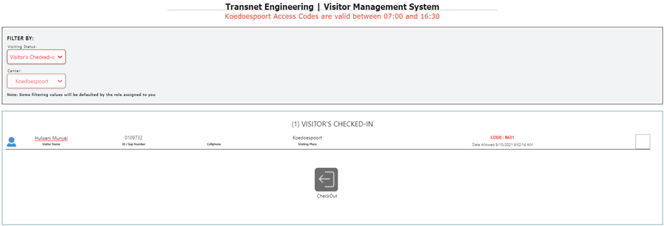
Visitor Confirmation
Once available then the Security Officer will initiate the check-in process by ticking the check box of the registered visitors and click icon at the bottom of the screen to allow the Visitors access to the Transnet premises and the
pop-up message box will appear with a prompt question which reads “Are you sure you want to Allow Access to this Visitors?” if sure then click icon and the numbers of Visitors on the lobby will be updated accordingly

Slide 32
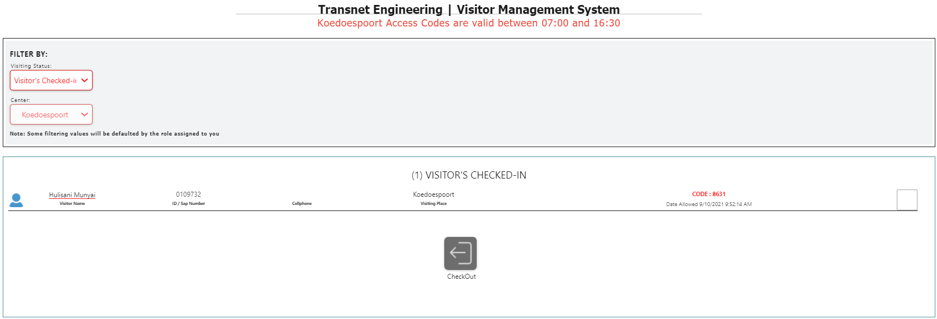
Visitor Checked In
To confirm whether the Visitor was successfully checked-in then select the Visitors Checked-In Filtered option.

Slide 33
Visitor Check out process
Note: The access code will be valid for a day and the same code will be used for a pass-out purposes
Upon leaving the Transnet premises or after Business hours, then it is the duty of the Security Officers to check out all the day Visitors and this should be done just before end of Business hours.

Slide 34
SAP New Password Screen
The Security Officer will initiate the check-out process by ticking the check box of the visitors and click icon at the bottom of the screen to check-out the Visitors to the Transnet premises and the
pop-up message box will appear with a prompt question which reads “Are you sure you want to Checkout this Visitors?” if sure then click icon and the numbers of Visitors on the checked-in will be reduced and the checked out status will be increased instead.

Slide 35
Final Visitor check out

Slide 36
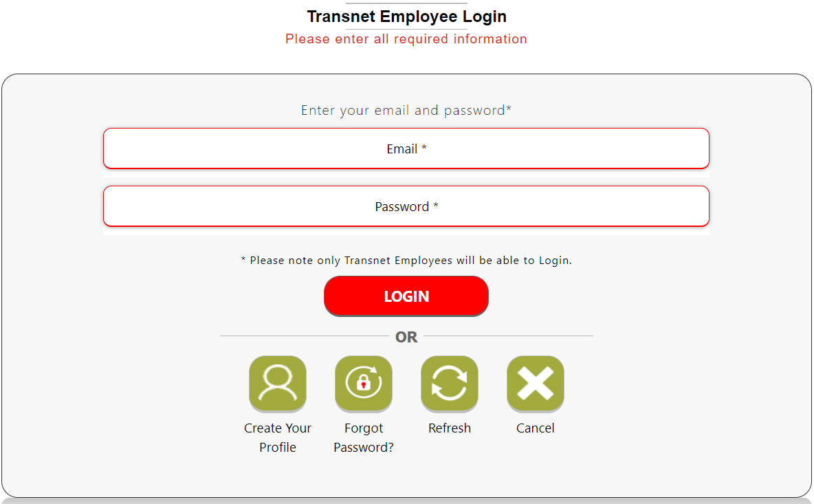
Transnet employee login
Employees enter their details

Slide 37
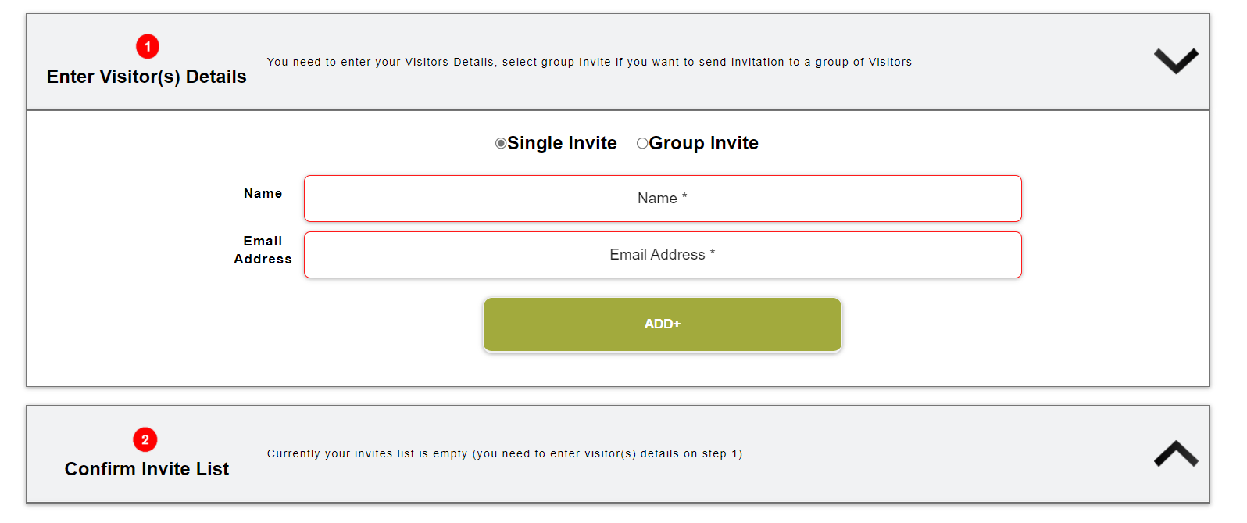
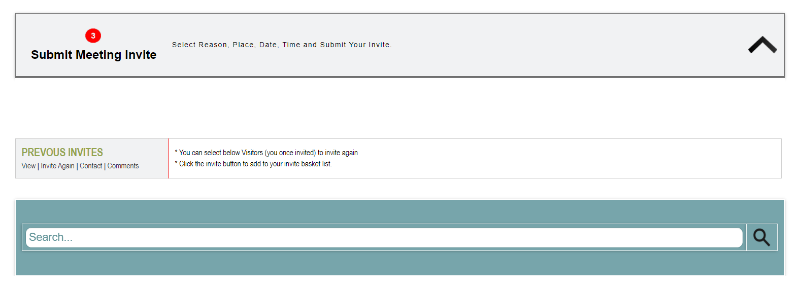
Transnet employee home screen
The employee landing page will have options of single or group invitations.

Slide 38
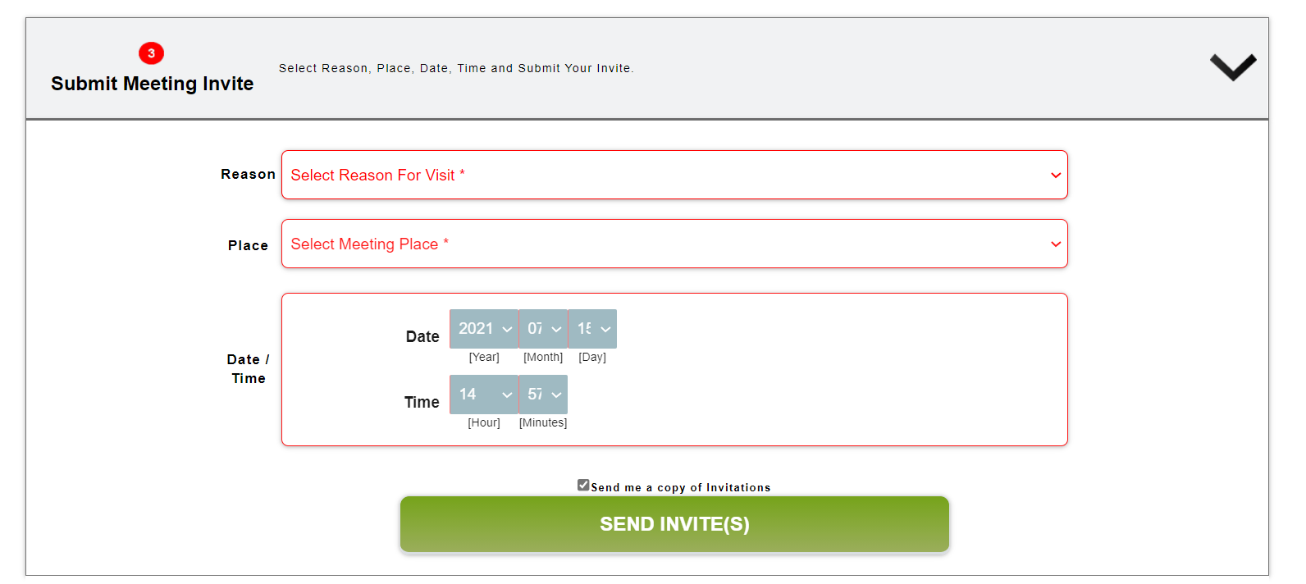
Single invites
The employee will confirm meeting details.

Slide 39
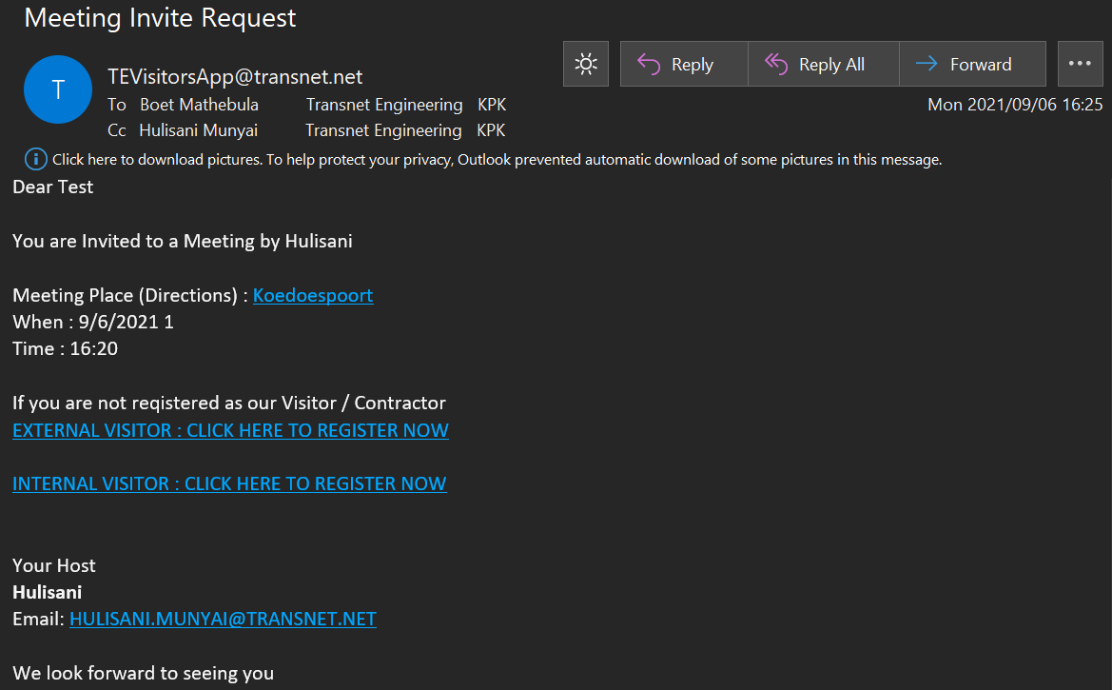
Invite email
The email invite will have the basic details of the meeting

Slide 40
Group invite
The group invite will appear for employee to confirm

Slide 41
Group invite: summary of invitees
The group details should be summarised

Slide 42
Group invite: summary of invitees
The group invite details should be captured in the email

Slide 43
Change Readiness Awareness

Slide 44
Change Readiness Assessment (CRA)
Question | Agree | Disagree
I can articulate the objectives of the Visitor App project
The sponsor has clearly articulated the objectives of the Visitor App project through email communications.
Leadership is committed to the Visitor App initiative
The project has been communicated to all
There is a two way communication between the project team and the impacted stakeholders
The current “go-digital” culture is aligned to the Visitor App project
What support would you like to attain from the Change management and Project team

Slide 45
CRA
Question | Agree | Disagree
I think there is justification for the Visitor App initiative
I have a clear picture/vision of what the Visitor App initiative is trying to achieve
I understand the needs of the Visitor App initiative
I understand the scope of the Visitor App project
I support the scope of the Visitor App initiative

Slide 46
THANK YOU

